Slide 1
Smith Marine Fish Farm
Team 4: Zhe Xue, Samuel, Naason, Claudia, Qing Ling

Slide 2


Purpose
The main purpose of our solution is to assist Smith Marine’s fishing farm in monitoring their seafood livestock remotely and alert the respective staff when any environmental threats or issues are being encountered.
This can be conducted through the installation of an IoT water monitoring system which comprises of 3 sensors to observe the water conditions and report back to Smith Marine with the appropriate insights regarding these 3 components:
1. Temperature
2. Electrical Conductivity
3. pH Level

Slide 3
Implementation of Machine Learning
We can use machine learning model to process the data pass by the sensors in real time such that if the model predicts that the fish will die, it will check if EC, Temperature or PH value is above or below a recommended amount. It will then take the necessary precautions and notify the administrator.

Slide 4
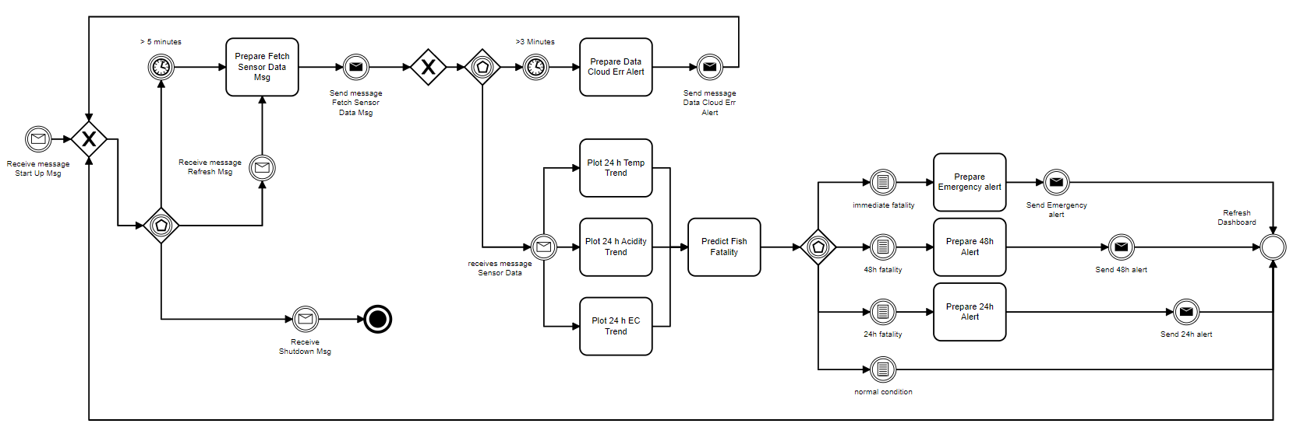
Methodology & Design

Slide 5
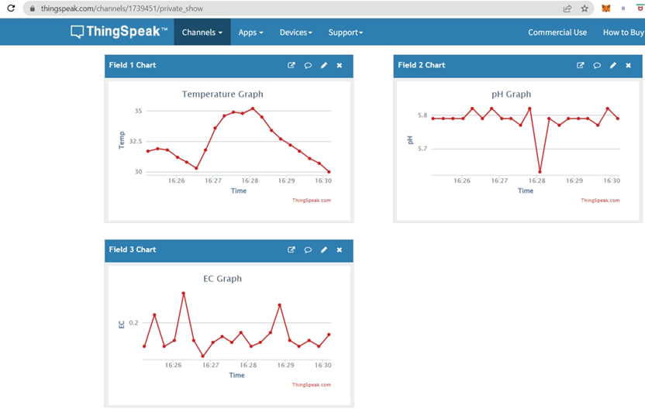
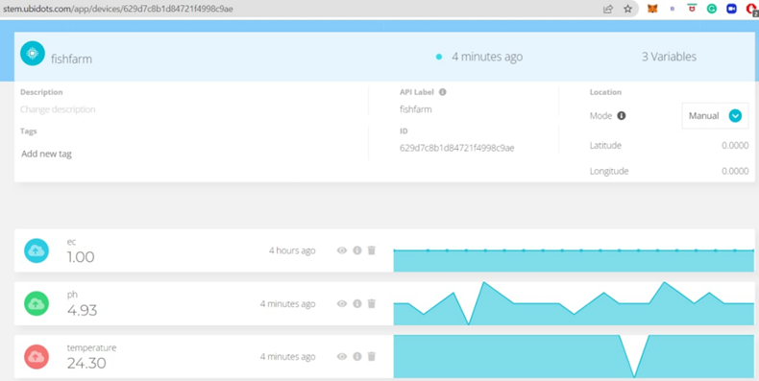
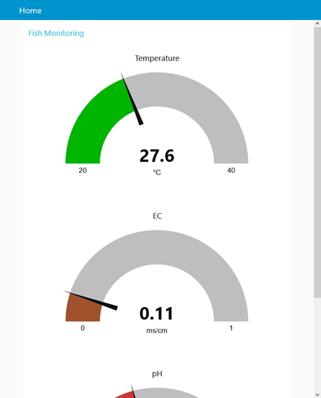
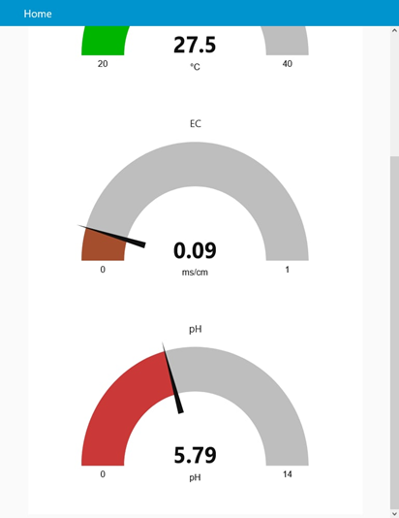
Findings

Slide 6
Results

Slide 7
Conclusion
The team's sensor design for the monitoring of the livestock in the fish farm helps the solution for Smith Marine Fish Farm main problem.
With the sensors, we will be able to collect and record readings on an hourly basis.
1) Temperature sensor for temperature monitoring.
2) pH sensor for the pH monitoring of the water and its acidity.
3) EC sensor to measure electrical Conductivity of the water.
The readings that are collected will be displayed in an IoT platform (Ubi Dots) to be able to be analysed and visualized to monitor and track all information about the fish farm. Ubi Dots will also allow the fish farm owners to set notifications by email or SMS to conditional events defined by the owners. For example, rising temperatures or increasing pH, both which threatens the lives of the fishes.

Slide 8
Conclusion: Machine learning
For the Machine Learning, Predictive Models, as we compare the performance of matrices, such as accuracy, precision, recall, and F1 score, based on each model that was done, we are able to come up with a concluding result, as Random forest Classifier being the best model to be the use case to be used, as it has the highest accuracy scores, precision, recall and F1 score comparing it to other models. Although there is a close percentage between the decision tree and random forest, the risk of overfitting the data is lower in random forest, so it would be more of a reliable machine learning model overall. With that Random Forest is selected to be used for the fish farm project.

Slide 9
Recommendations
Increased of EC value by having nutrients added to the water tank, the EC of the water can be increased by having concentrated aquaponics solution. As EC is about having the number of ions in the water. With higher number of ions, there is greater EC in the water. A higher EC means higher salt concentration.
As for water temperature if the temperature ever goes higher, the livestock in the fish farm might get affected by the high temperature negatively. So, it would be recommended to lower down the temperature by preventing a lot of light from the water in the fish farm.

Slide 10
Recommendations
For pH very high or low pH values are unsuitable for aquatic organisms. Young fish and immature stages of aquatic organisms are extremely sensitive to pH levels below 5 and may die at low level pH values. But high levels of pH value could also harm fishes by denaturing cellular membranes.
To lower down the value, maybe the use of current water use with fresh water is one way to lower pH level. Which is a partial water change. To raise it, maybe a used of crushed limestone in the fish farm which is calcium carbonate, that neutralize the acids and acts as a buffer to keep the pH level from changing.

Slide 11
Recommendations: Machine learning
As for the Machine Learning area, the team decided to propose to adopt the Random Forest classifier model for the fish farm project. As it has the highest scores based on accuracy, precision, recall and F1, meaning that it has the best performance matrices. Although there is a close percentage between the decision tree and random forest, the risk of overfitting the data is lower in random forest, so it would be more of a reliable machine learning model overall.

Slide 12
Chosen Predictive Model
Random forest
Random Forest Classifier is an algorithm model that utilises multiple Decision Trees model to predict results based on the most popular class.

Slide 13
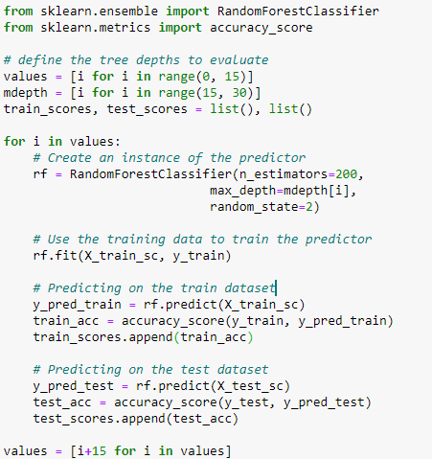
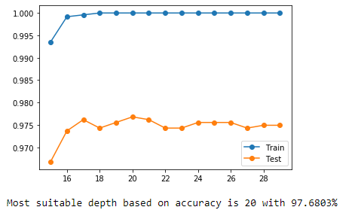
Random Forest

Slide 14
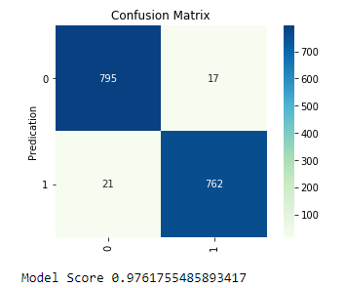
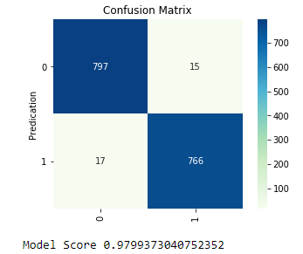
Random Forest
Before: Accuracy: 97.6176%, Precision: 97.6221%, Recall: 97.6122%, F1 Score: 97.6165
After Hyper-parameter tuning: Accuracy: 97.9937%, Precision: 97.9955%, Recall: 97.9908%, F1 Score: 97.9930%

